Slide 1
Controlled Interactivity
Lean-back media experiences based on lean-forward technologies
Ingar Arntzen, Njål Borch, Anders Andersen

Slide 2
Systems Research: Multimedia
Capture
Formats, compression
Distribution
Rendering
Streaming protocols, services
CDN’s
360 video
VR, AR, XR
AI
Mostly about video!

Slide 3
FTC 2023 - Future Technologies Conference 2023
2-3 November 2023 | San Francisco, United States
State Trajectory
A Unifying Approach to Interactivity with Real-Time Sharing and Playback Support
Ingar Arntzen, Njål Borch, Anders Andersen

Slide 4
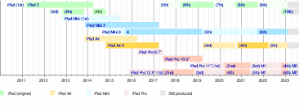
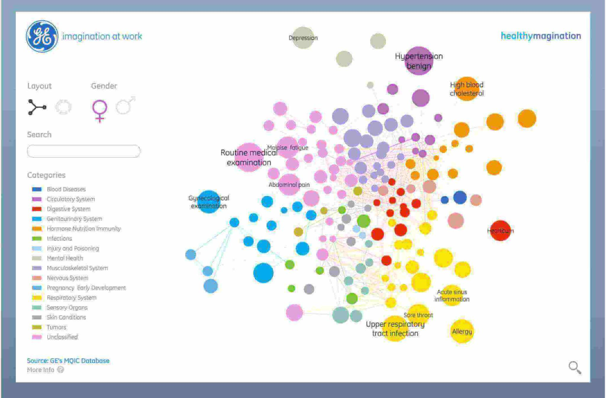
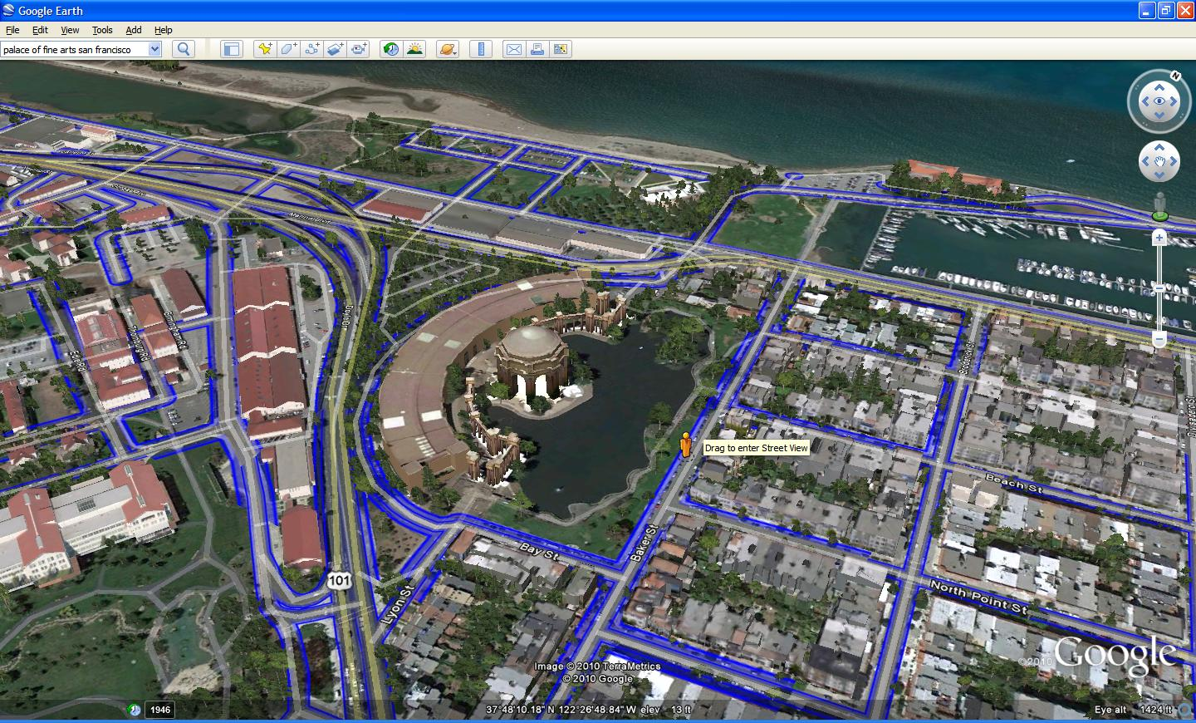
Interactive Render Tools
exploration and content creation
selection, filtering, customization, navigation
instant feedback
scroll, zoom, pan, adjust, rotate, tilt, animate, rewind, play, toggle, next, drag, hide, re-order, unmute, center, slide

Slide 5
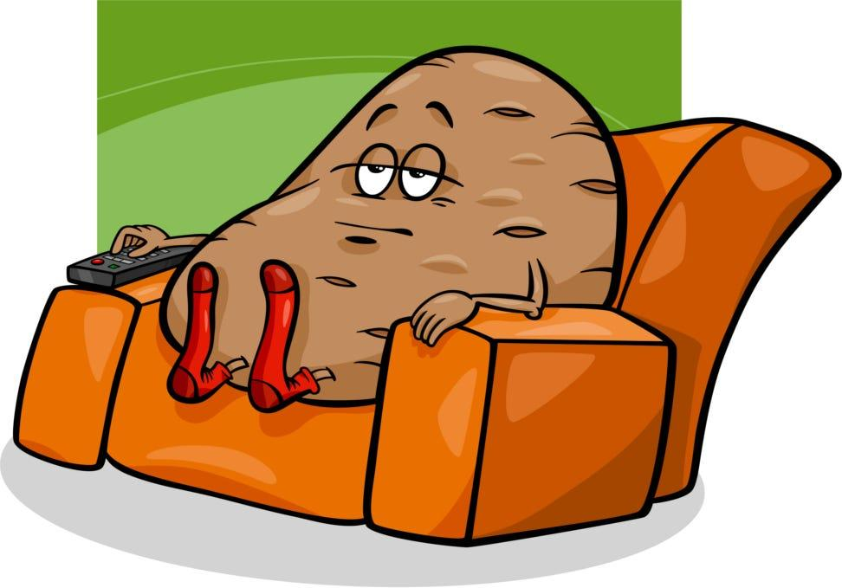
Lean-forward
Maps, timeline, dataviz, piano …
User is active Tell your own story
Lean-back
TV, radio, video, podcast, theatre…
User is passive Someone else tells a story

Slide 6
Idea
Problem
Provider | Interface | User
Using lean-forward tools for lean-back experiences?
Remote control the user experience ?

Slide 7
Why?
Lean-back storytelling - with all the advantages of lean-forward technologies
adaptation, customization, personalization, interactivity, lightweight, real-time data sources, powerful rendering tools
flexibility of technology appears to be under-exploited!
Automation
AI’s and LLM’s are excellent for content production
What if they could tell stories by remote controlling our lean-forward interfaces?

Slide 8
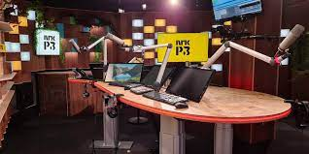
Example Application
Parallell presentations
Video/Audio + Interactive UI
Visual Radio/Podcast
HOST:
play with interactive tool while recording audio
VIEWER:
tap into interactive visuals while listening
pivot official narrative vs private exploration

Slide 9
Challenges…
share control over Internet in-real time?
latency, bandwidth, …
support support dynamic control signals?
transitions, animations, pointer-driven control, …
support timeline consistency?
playback with a media timeline?
live, time-shifted or on-demand?

Slide 10
Related Work
Frameworks for animation and timed rendering
Distributed Synchronization
Data-driven control
e.g feed, playlist -> primitiv, limited to data
Collaboration & Multiplayer Games
e.g. miro, unity, unreal -> real-time control

Slide 11
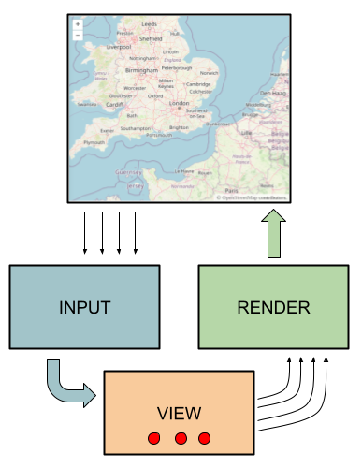
Test Case
How to remote control a 2D Map?
Demanding test case
Control
internal variables (lat, lon, zoom)
animations for smooth transitions
Idea
sharing variables online => COLLABORATION
rewinding and replaying variables => LEAN-BACK

Slide 12
Contribution
State Trajectory
variable with timeline
track control state through time
e.g. {lon, lat, zoom}
built-in support
online sharing, dynamic state change, time-shifting and playback

Slide 13
Evaluation
Integration OpenLayers Map
replace internal variables (lat, lon, zoom) with state trajectories
framework agnostic to changes
Support all standard map controls
New Capabilities
MapConference => Real-time map collaboration
MapCast => Replay map-session with media

Slide 14
API
 | Observable Variable | State Trajectory (cursor)
Update | a.value = new_value | a.value = new_value
 |  | a.trans (from, to, duration)
 |  | a.sample (value)
Access | a.value | a.value
 |  | a.dynamic
Observe | a.on(“change”, cb) | a.on(“change”, cb)
timeline controls API (TimingObject)

Slide 15
Key takeaways
Key idea - control as a (online) resource
State Trajectory
Generic concept - nothing to do with maps!
Built-in support: real-time control sharing, transitions, timeline playback
Simple usage - similar to programming variables
Control as a Service?
Step towards lean-back storytelling with powerful interactive technologies!

Slide 16
Ingar Arntzen
inar@norceresearch.no

Slide 17
Demos
Map Cast
https://ovar.norceresearch.no/demo/ol/cast/
Map Collaboration
https://ovar.norceresearch.no/demo/ol/coll/

Slide 18
Part 2 - Bigger picture
User demands diversifying in media
One-size-fits-all broadcast?
Multi-device immersion?
Customize experiences?
Accessibility features?
Personalized coverage?
Interactive data visualization?
Social integration?
Bleeding live or improved on-demand?
Solution ?
parallel coverage on multiple platforms

Slide 19
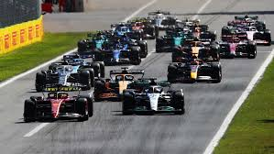
Example: Formula 1 (F1)
F1 TV World Feed
Professionally produced broadcast channel - global audience
F1 TV - Web streaming with 20+ channels
a few produced channels
various camera angles from cars and track
timing information ++
F1 App
interactive visualizations of race statistics
pit stops, overtakes, tire wear, gas levels, …
Interactive map with race track and cars
playback of vehicle gps tracks
Social commentary

Slide 20
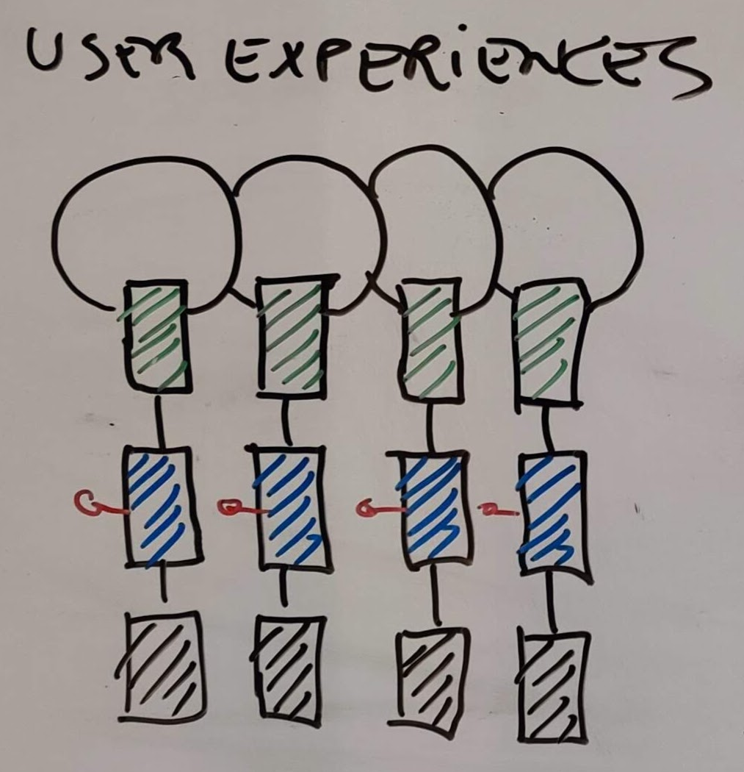
Combined Usage?
F1 World Feed + F1 TV + F1 App
Issues
manual setup
conflicts and no coordination
differences in delay
no help finding the good bits
Reasons
independent platforms
independent user experiences
production partly shifted to consumer

Slide 21
Cross-platform media experiences
Single user experience, across platforms
Production tells a story across all interfaces, consistent with a common timeline and narrative
User may lean back or engage. Interactivity affects the experience as a whole

Slide 22
Some challenges…
How to remote control interactive interfaces?
How to coordinate between interfaces?
How to ensure timeline consistent rendering in data-driven interfaces?
How to control things differently for different people?
How to ensure quality and brand control?
How to keep costs and complexity down?
How to automate?
How to build this on top of existing infrastructure?

Slide 23
Hypothesis
Control seems to be a recurring theme…
Generic support for cross platform can be addressed as a fundamental feature of the media model.

Slide 24
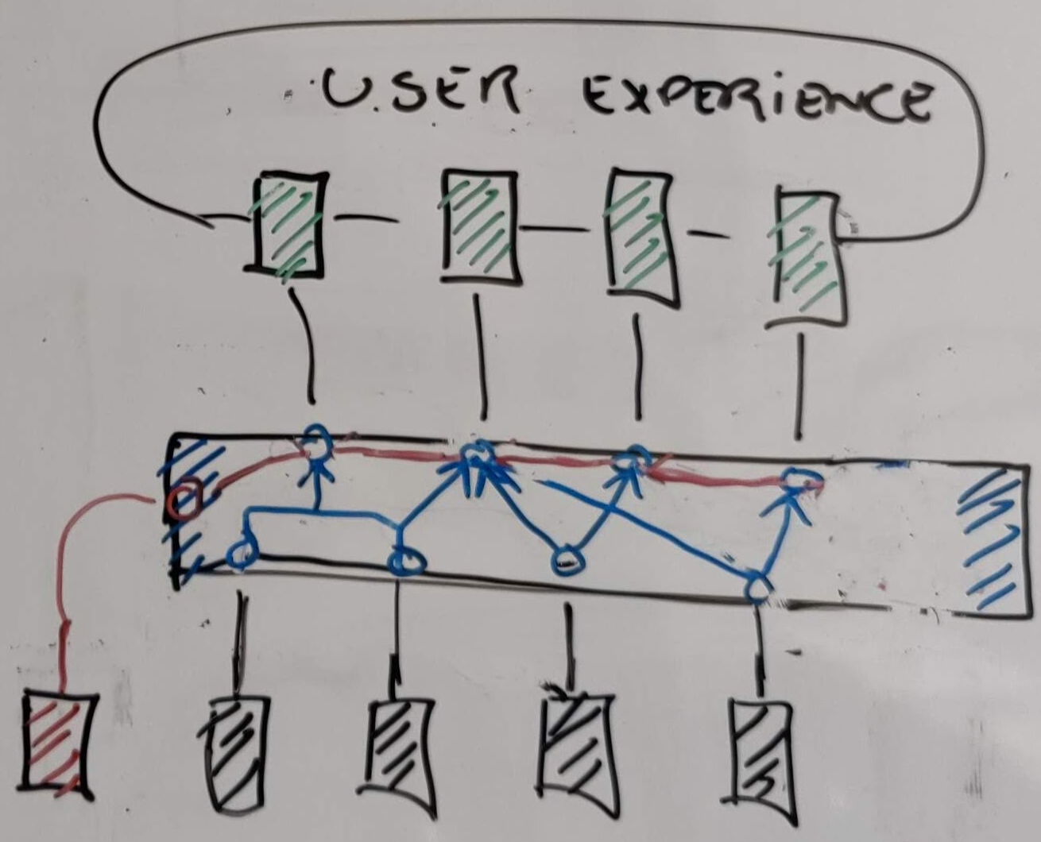
New Media Model?
Control as key concept
online resource
timeline consistency, time-shifting
Virtual state layer
Conversion of data to rendering state
Driven by control resources
=> consistent rendering
Infrastructure for data access and rendering unchanged.

Slide 25
Academic interest
Control has been a peripheral theme in media systems research.
We think it should be center stage.

Slide 26
Ingar Arntzen
inar@norceresearch.no

